Slide 1

Fraud Lawyers Association Presentation:
Scientific Analysis of Art
27th March 2019
Francis Eastaugh
Director, Business Development
Art Analysis & Research
Notes:
Technical support services

Slide 2
Fakes and Forgeries
New problems?
New solutions.
Good actors and bad actors.
High cost of failure for transactions.

Slide 3
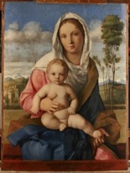
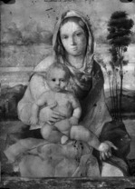
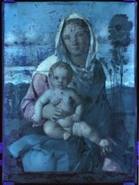
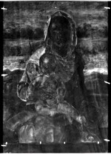
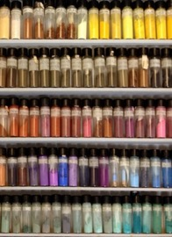
What is scientific art analysis?
Proprietary Data
& Data Analytics
Subject Matter
Experts
Technical Imaging
+
Material Analysis
+
+
Paints & Inks
Visible light
Infrared
Spectral Libraries
Wood, Paper & Canvas
Ultraviolet
X-ray
Ceramics, Metals & Alloys
Pigmentum Collection

Slide 4
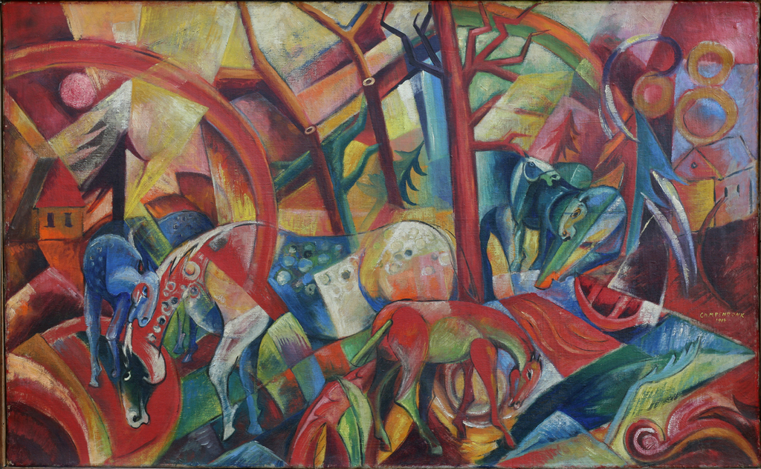
Case Study - Campendonk

Slide 5
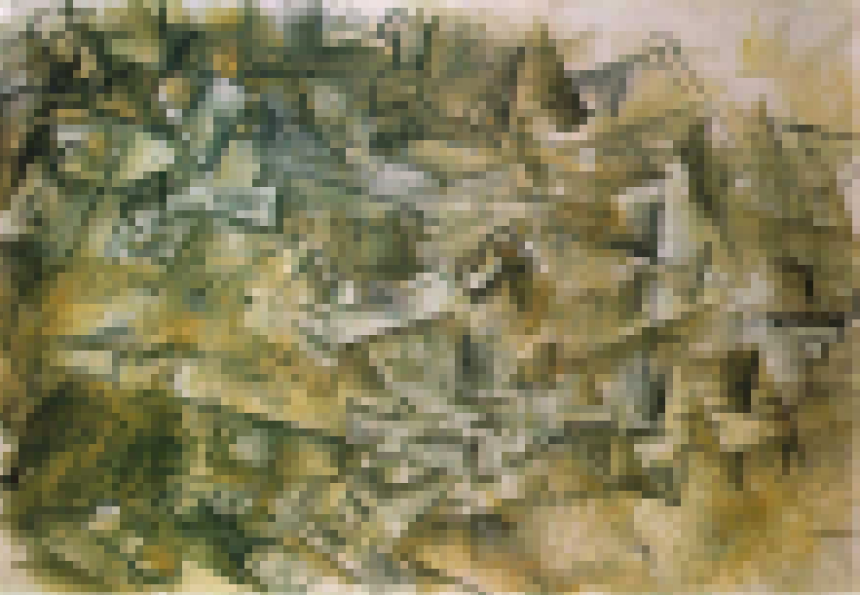
Case Study – Double Trouble

Slide 6
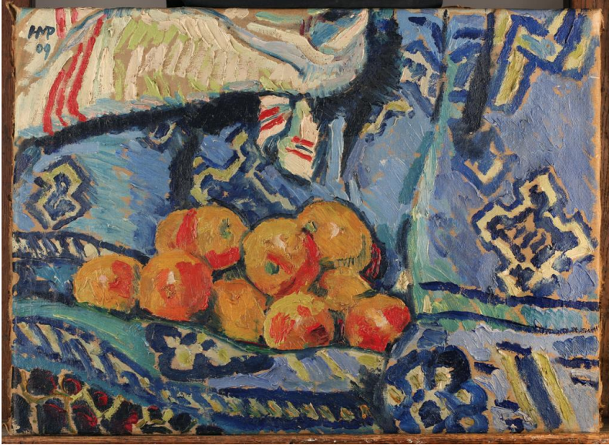
Case Study - Pechstein

