Slide 1

Slide Layout:
Blank slide
  This is more engaging than a blank screen and helps reinforce audience awareness of RPC
  Do not alter the size of the slides without consultation with DPD,

Slide 2
Theft and money laundering in the art market
Slide Layout:
Title slide
  This should remain plain and white although a suitable client logo can be placed on the right hand side, but must not interfere with the RPC logo
  The presenter name placeholder is bottom aligned, and expands up for multiple presenters
Presentation to the Fraud Lawyers Association
Davina Given
27 March 2019

Slide 3
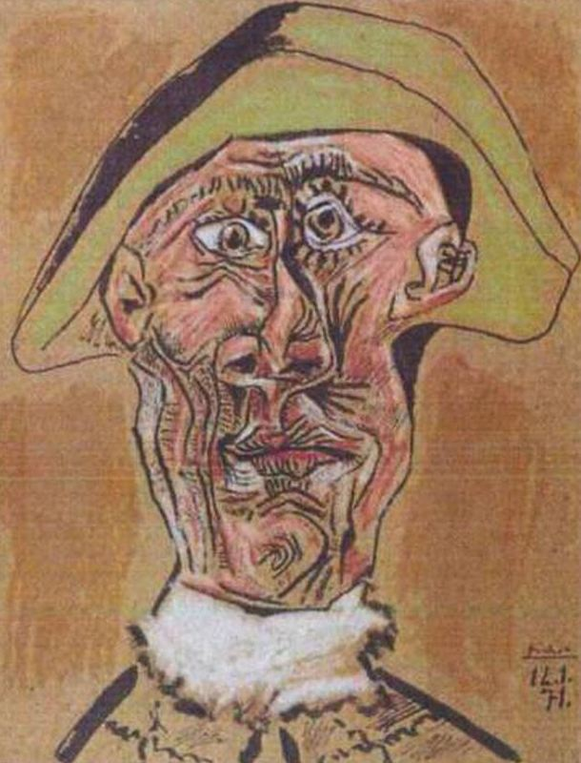
Art theft: the advantages of portability
Slide Layout:
Simple Bullet list
Simple bullet list
  The simple bullet list slide has a main slide title and bullets only. There is no subheading or introductory text.
  Traditional theft
    S1, Theft Act 1968, etc
  War plunder
    1815 restitution of works seized by Napoleon
    1954 Hague Convention for the Protection of Cultural
      Property in the Event of Armed Conflict
      Cultural Property (Armed Conflicts) Act 2017
  Nazi looting 1933-1945
    Washington Principles 1999
    Spoliation Advisory Panel
    US HEAR Act

Slide 4
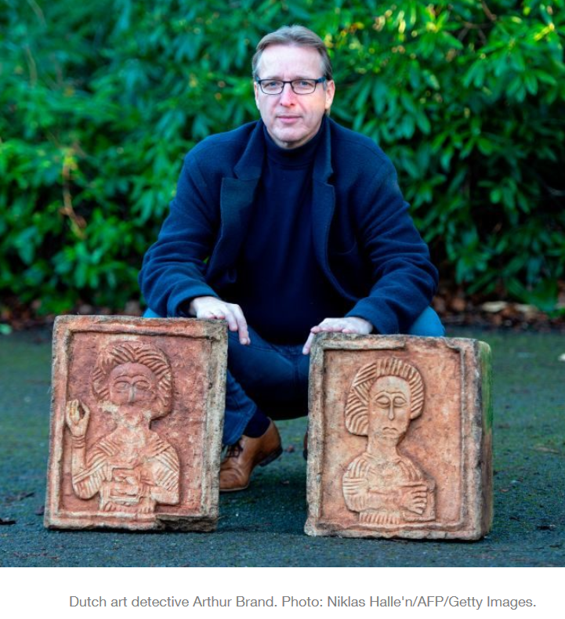
Stolen art: the disadvantages of uniqueness
Slide Layout:
Simple Bullet list
Simple bullet list
  The simple bullet list slide has a main slide title and bullets only. There is no subheading or introductory text.
  Locating stolen art
    Private art recovery specialists
    Art & Antiquities Squad / other police organisations
  Buying stolen art
    Art Loss Register
      The Medici papers
    Ss 3 and 4, Limitation Act 1980
    Conflicts of laws: lex situs vs lex loci actus
    De facto bans on sale / export
      Sevso silver

Slide 5
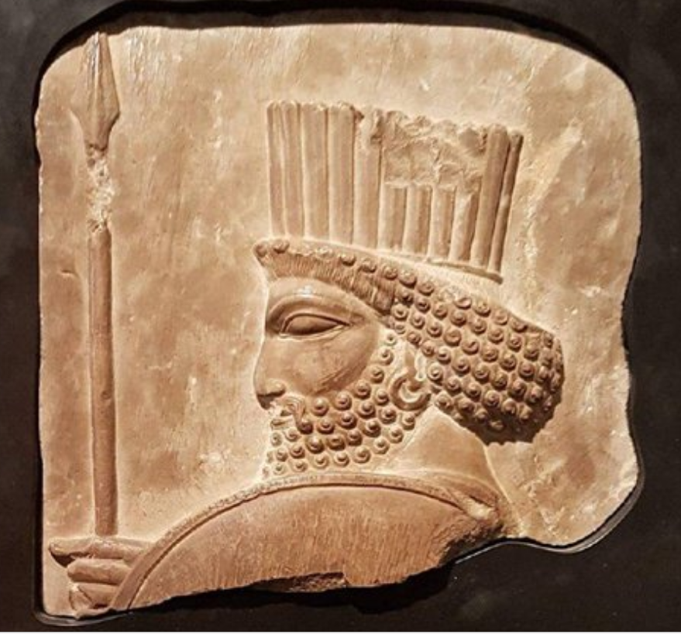
Antiquities: a special case
Slide Layout:
Simple Bullet list
Simple bullet list
  The simple bullet list slide has a main slide title and bullets only. There is no subheading or introductory text.
  1970 UNESCO Convention
  Additional offences
    Dealing in Cultural Objects (Offences) Act 2003
    Iraq (United Nations Sanctions) Order 2003
    Export Control (Syria Sanctions) Order 2013
  Draft EU Regulation on the introduction and the import of cultural goods
  US approach

Slide 6
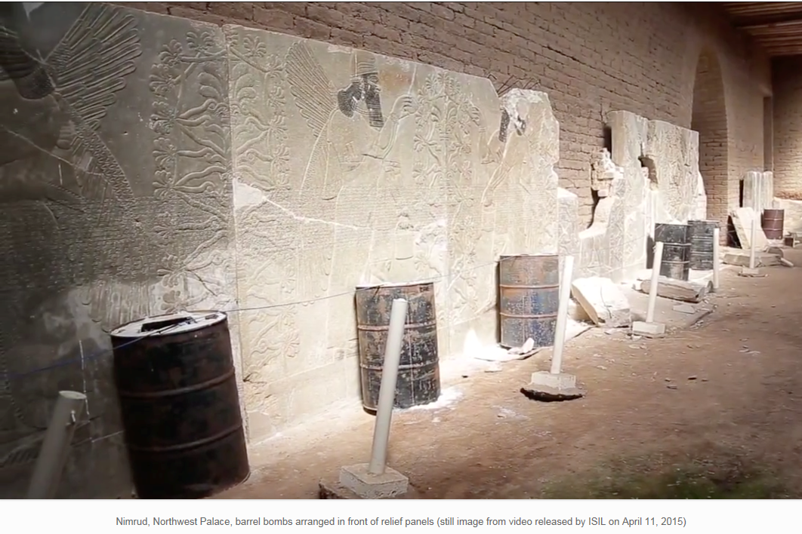
Money laundering
Slide Layout:
Simple Bullet list
Simple bullet list
  The simple bullet list slide has a main slide title and bullets only. There is no subheading or introductory text.
  4MLD / Money Laundering, Terrorist Financing and Transfer of Funds (Information on the Payer) Regulations 2017
    "high value dealer" if payment in cash ≥ EUR 10,000
  5MLD in force January 2020 – cash criterion removed
    Art fairs
    Dealers as agent or principal
    Auctioneers: when to perform CDD and on whom?
    Resources required
    Treasury approved guidance?
  US legislation?

Slide 7
Theft and money laundering in the art market
Slide Layout:
Holding Slide – Purple
Holding slide
  Used at the end of the presentation when a question and answer session is planned
Q&A

